Slide 1
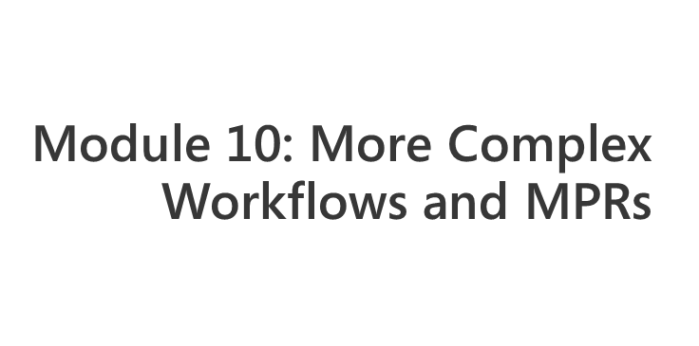
Notes:
Module x: Title
Course xxxxy
Presentation: xx minutes
Lab: xx minutes
This module helps students to ….
After completing this module, students will be able to:
Objective #1.
Objective #2.
Objective #3.
Required materials
To teach this module, you need the Microsoft Office PowerPoint® file xxxxy_xx.ppt.
Important It is recommended that you use PowerPoint 2002 or a later version to display the slides for this course. If you use PowerPoint Viewer or an earlier version of PowerPoint, all the features of the slides might not be displayed correctly.
Preparation tasks
To prepare for this module:
Read all of the materials for this module.
Practice performing the demonstrations and the lab exercises.
Work through the Module Review and Takeaways section and determine how you will use this
section to reinforce student learning and promote knowledge transfer to on-the-job performance.
If this is a KonaH product, use this section:
Make sure that students are aware that there are additional information and resources for the module on the Course Companion CD.
If this is a Forte product, use this section:
Make sure that students are aware that there are additional online resources for the module on the Course CD.

Slide 2
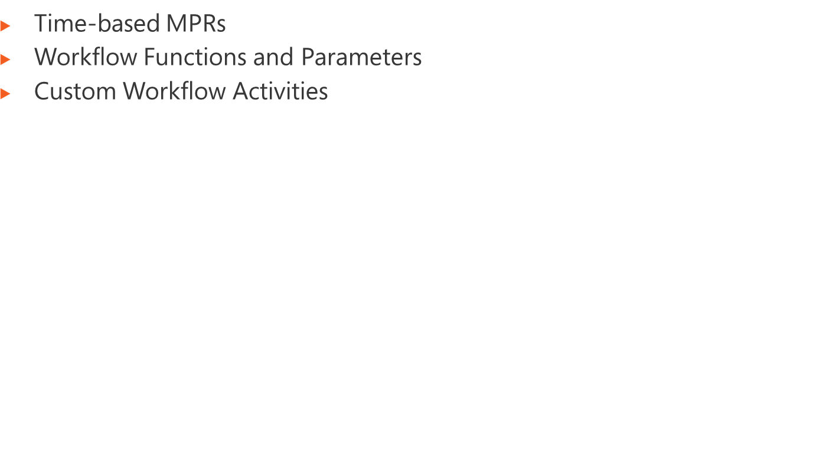
Notes:
Module x: Title
Course xxxxy

Slide 3
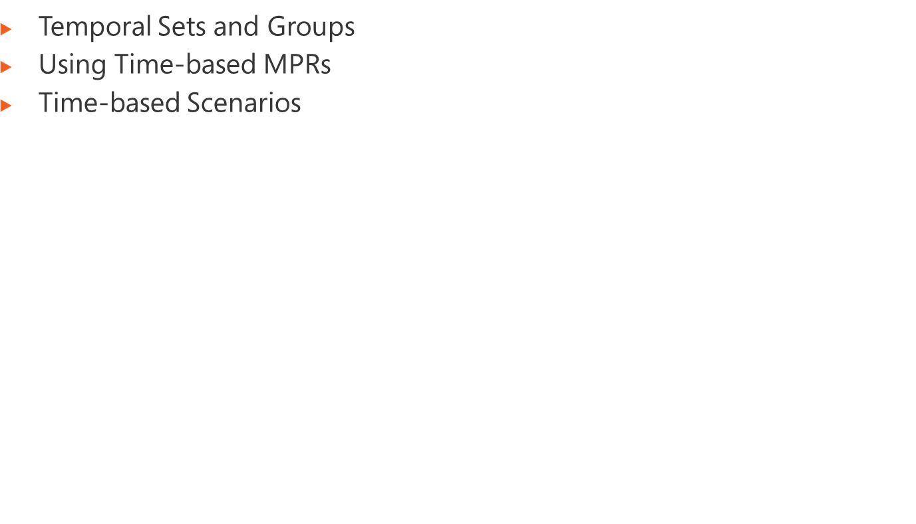
Notes:
Module x: Title
Course xxxxy

Slide 4
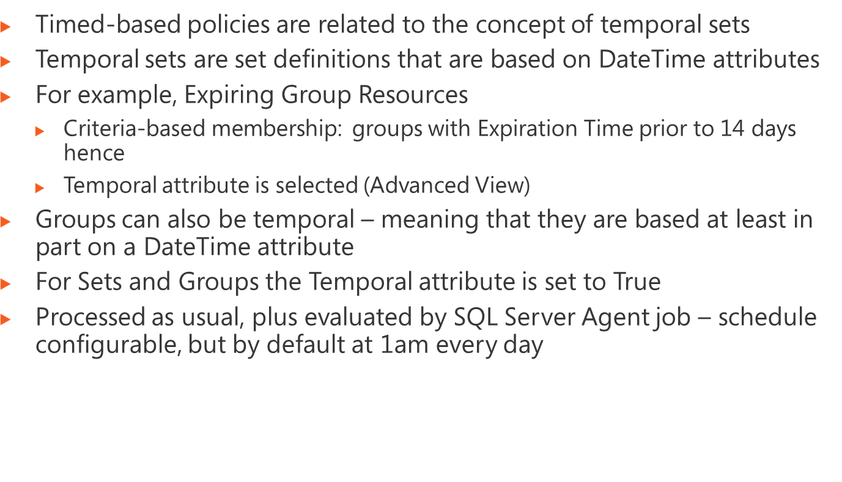
Notes:
Module x: Title
Course xxxxy

Slide 5
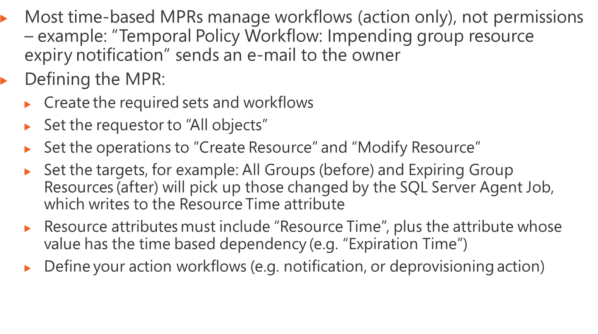
Notes:
Module x: Title
Course xxxxy

Slide 6
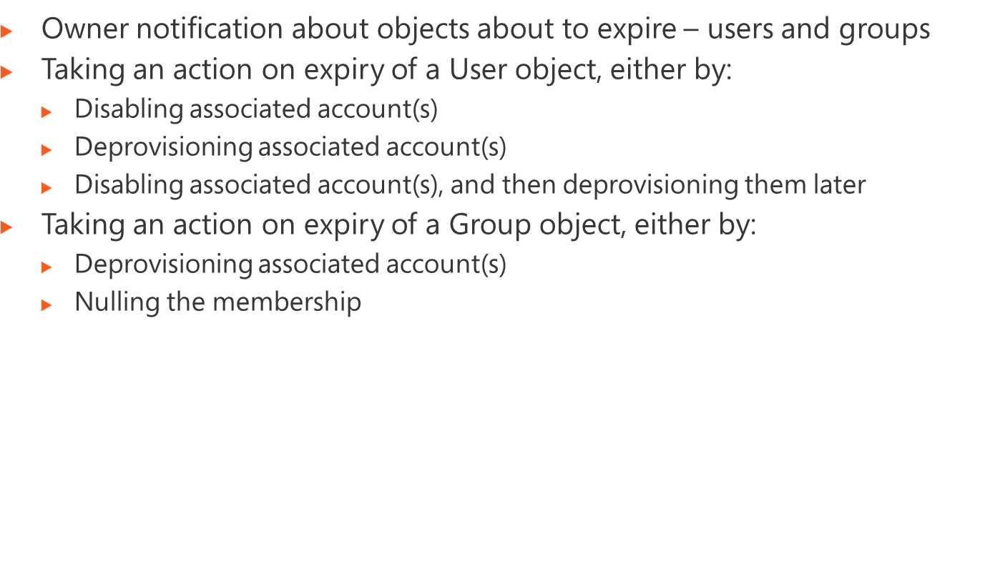
Notes:
Module x: Title
Course xxxxy

Slide 7
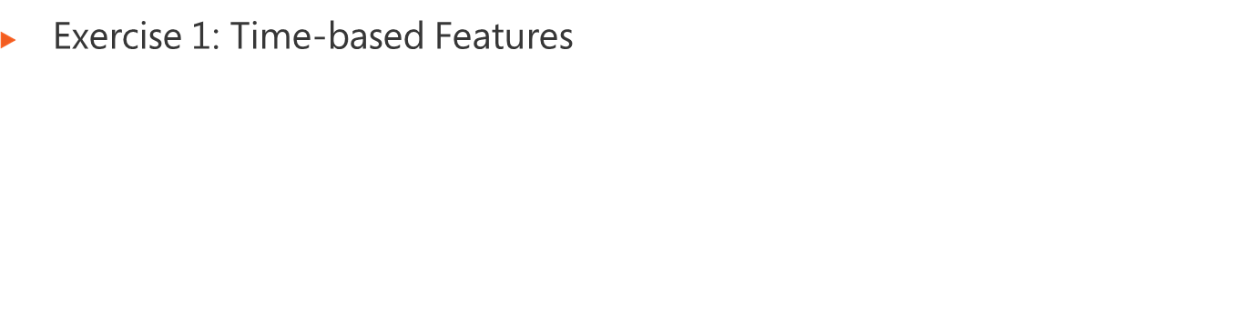
Logon information
Virtual machine | FIM2010RC1
User name | Administrator
Password | Pa$$w0rd
Estimated time: 60 minutes
Notes:
Module x: Title
Course xxxxy
In this lab, students will ….
Exercise 1
In this exercise, students ….
Exercise 2
In this exercise, students ….
Before the students begin the lab, read the scenario associated with each exercise to the class. This will reinforce the broad issue that the students are troubleshooting and will help to facilitate the lab discussion at the end of the module. Remind the students to complete the discussion questions after the last lab exercise.
If this is a KonaH product, use this note:
Note: The lab exercise answer keys are provided on the Course Companion CD. To access the answer key, click the link located at the bottom of the relevant lab exercise page.
If this is a Forte product, use this note:
Note: The lab exercise answer keys are provided on the Course CD.

Slide 8
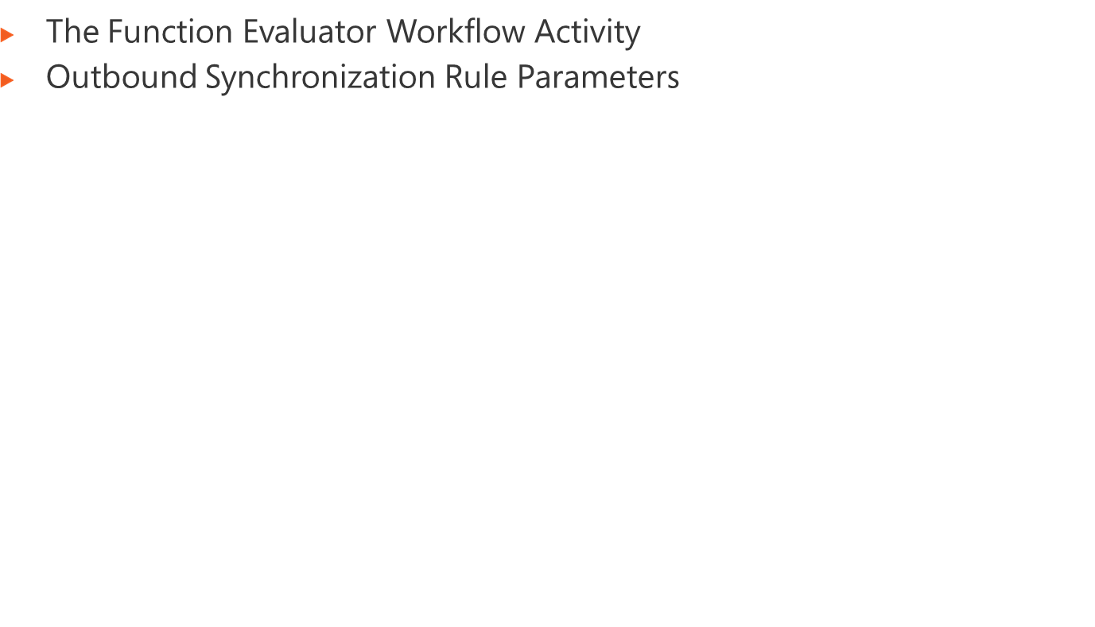
Notes:
Module x: Title
Course xxxxy

Slide 9
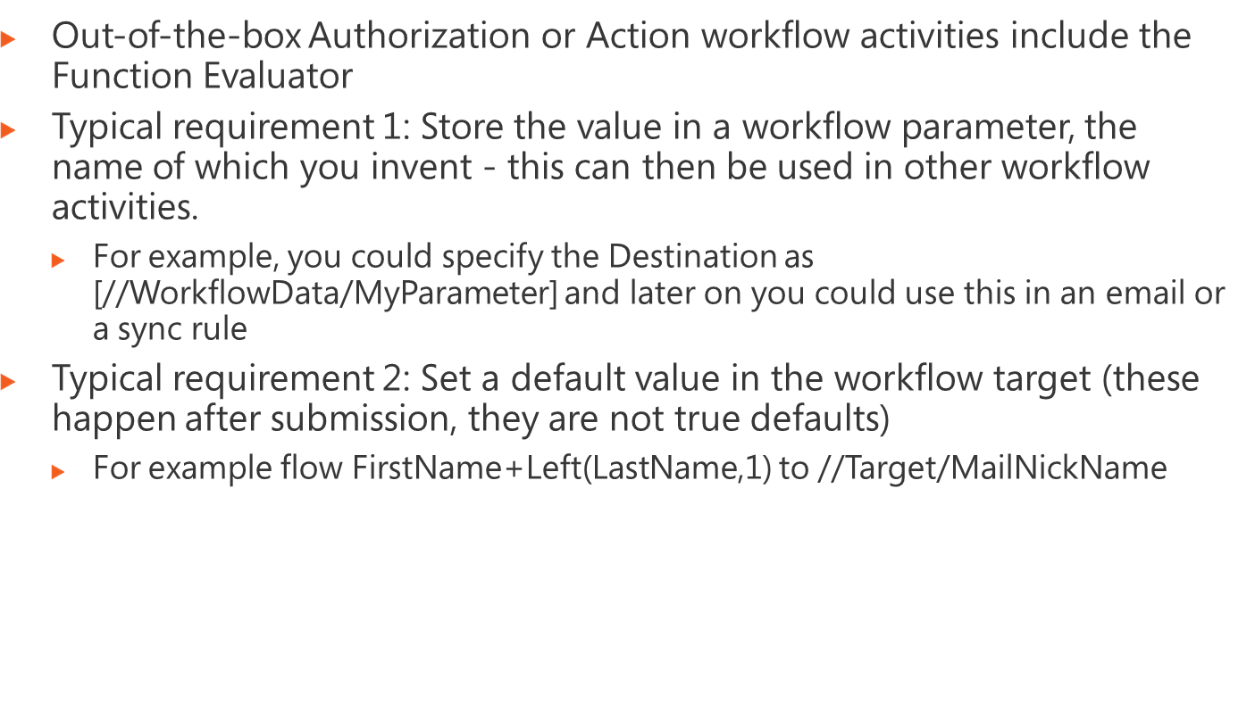
Notes:
Module x: Title
Course xxxxy

Slide 10
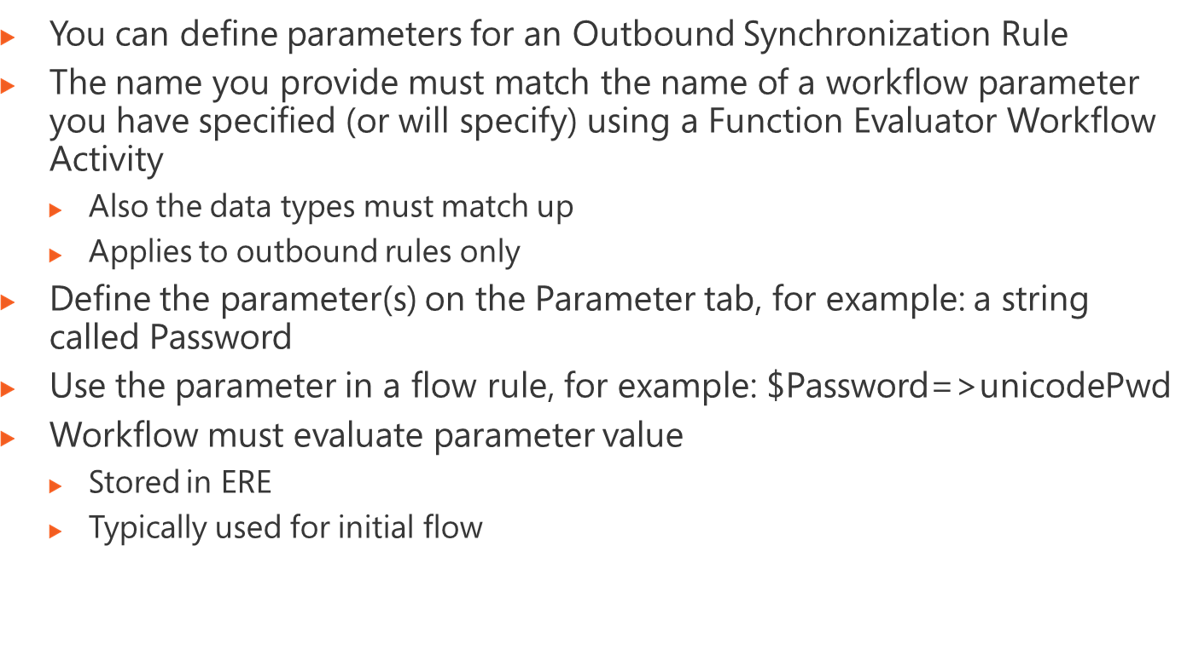
Notes:
Module x: Title
Course xxxxy

Slide 11
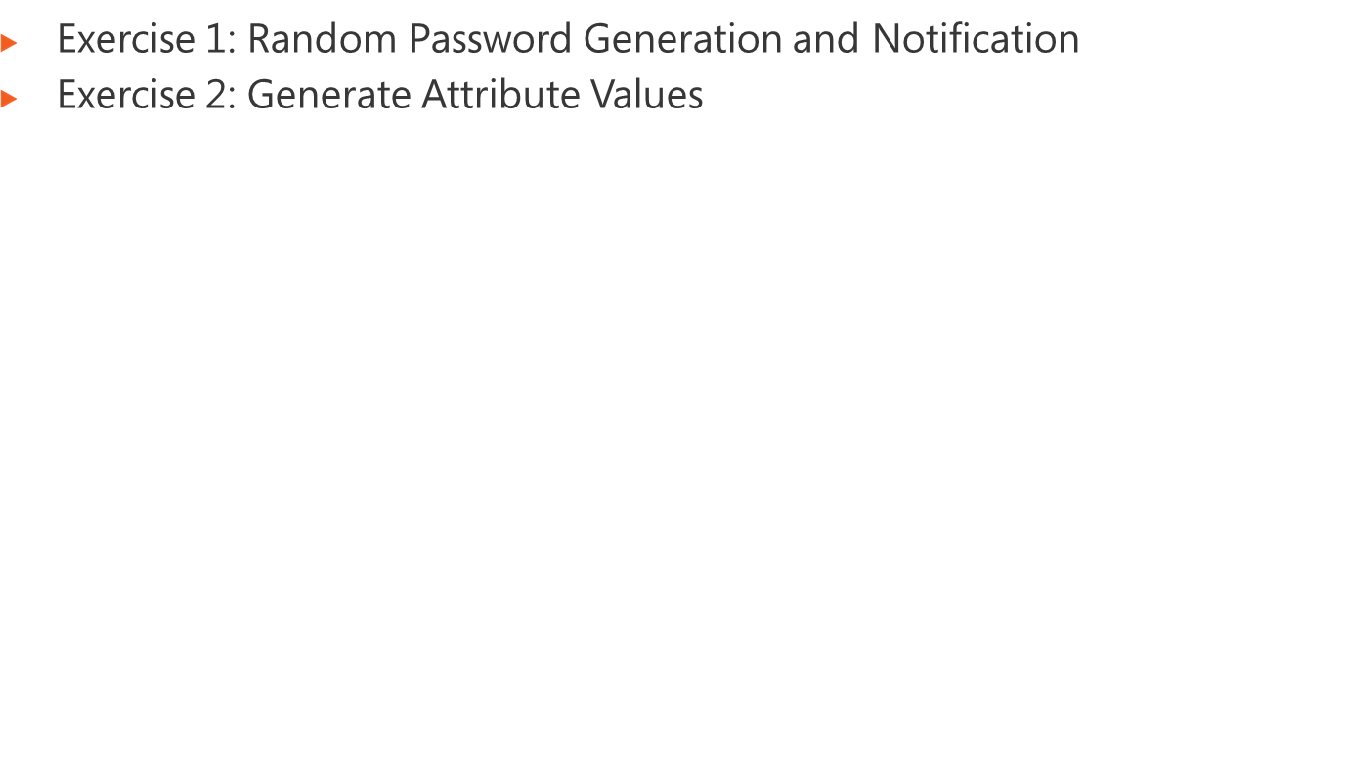
Logon information
Virtual machine | FIM2010RC1
User name | Administrator
Password | Pa$$w0rd
Estimated time: 60 minutes
Notes:
Module x: Title
Course xxxxy
In this lab, students will ….
Exercise 1
In this exercise, students ….
Exercise 2
In this exercise, students ….
Before the students begin the lab, read the scenario associated with each exercise to the class. This will reinforce the broad issue that the students are troubleshooting and will help to facilitate the lab discussion at the end of the module. Remind the students to complete the discussion questions after the last lab exercise.
If this is a KonaH product, use this note:
Note: The lab exercise answer keys are provided on the Course Companion CD. To access the answer key, click the link located at the bottom of the relevant lab exercise page.
If this is a Forte product, use this note:
Note: The lab exercise answer keys are provided on the Course CD.

Slide 12
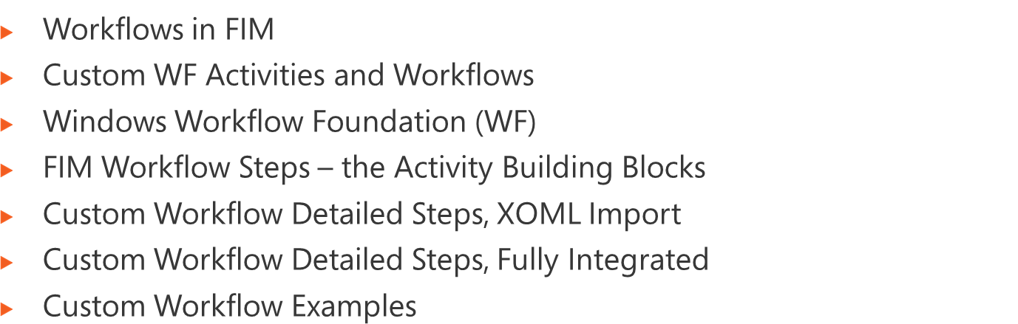
Notes:
Module x: Title
Course xxxxy

Slide 13
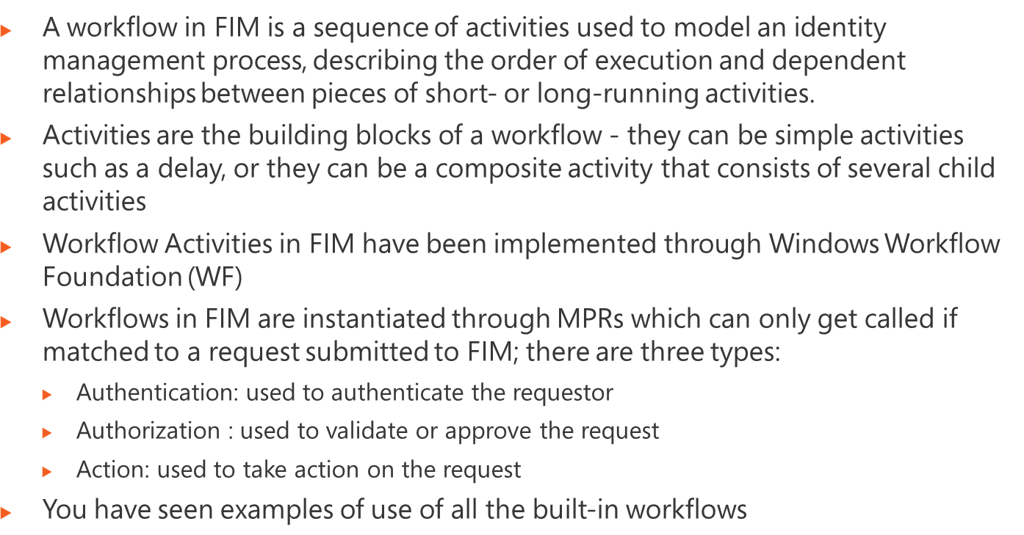
Notes:
Module x: Title
Course xxxxy

Slide 14
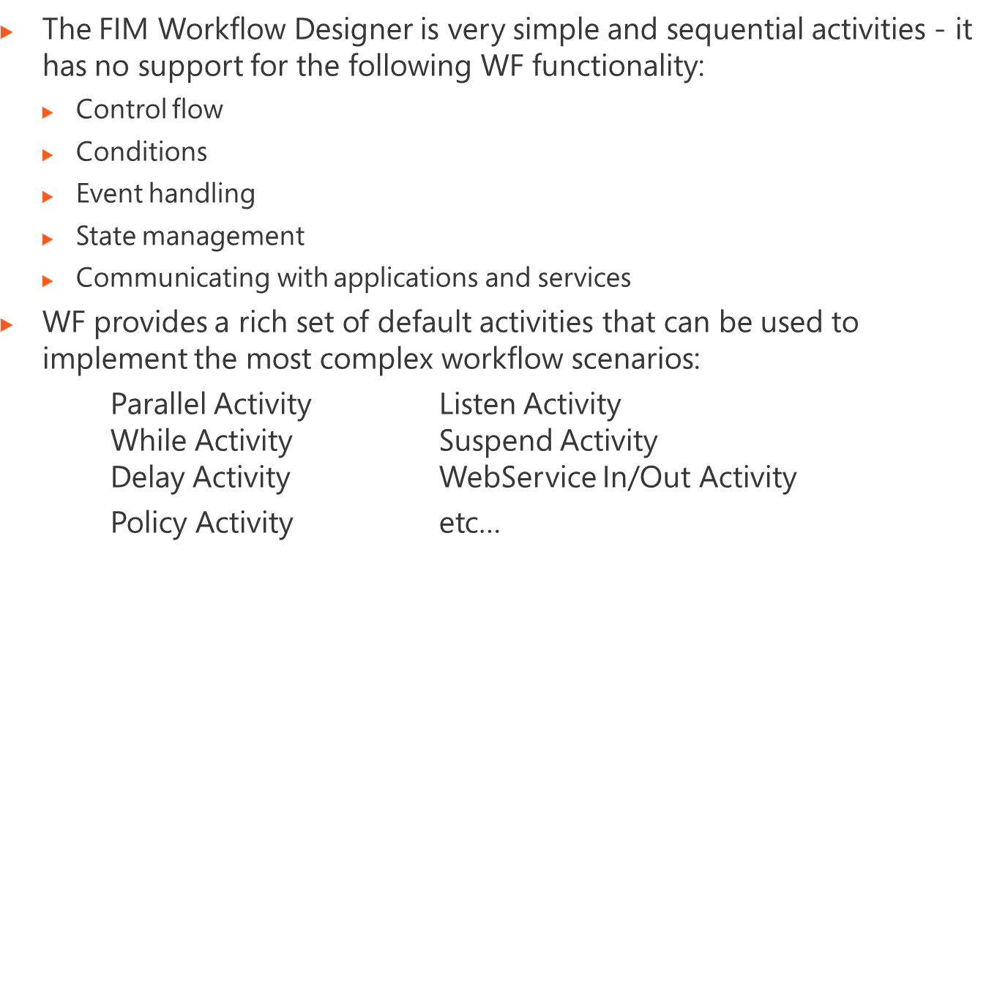
Notes:
Module x: Title
Course xxxxy

Slide 15
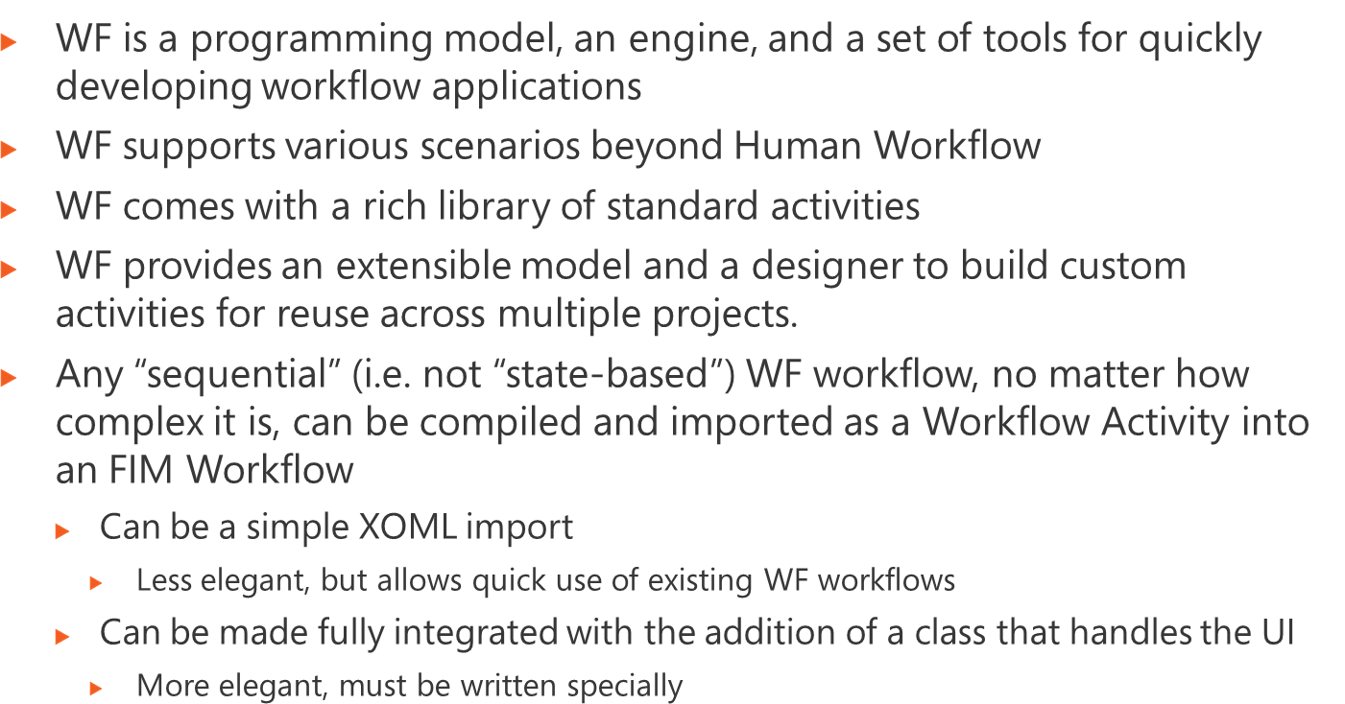
Notes:
Module x: Title
Course xxxxy

Slide 16
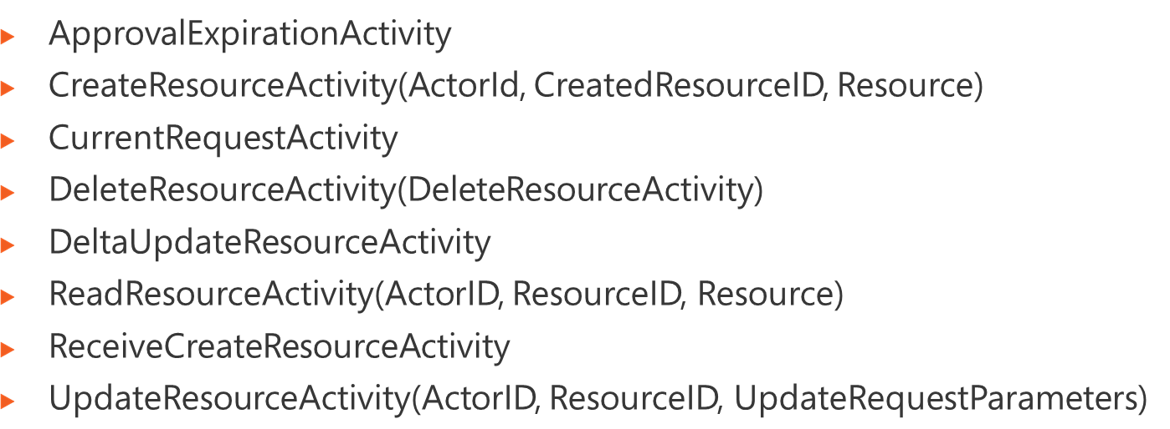
Notes:
Module x: Title
Course xxxxy
Are not available from the Portal Workflow Designer but are available from the WF designer
The CreateResourceActivity will be responsible for allowing users to create new instances of resources within the ILM data store. This activity will expose three public properties:
ActorId – A System.Guid representing the ObjectID of the actor resource to be used when calculating ManagementPolicyRules that affect this request. The ActorId will default to the parent request’s Creator attribute. It is important to note that this System.Guid can reference any resource in the ILM “2” system and not just Person resources. For example, it is possible for the current WorkflowDefinition to be used for the ActorId. This may be desirable in cases where resources should only be managed dynamically through workflow, thus enterprises can only grant rights to WorkflowDefinition resources and not Person resources.
CreatedResourceId – A System.Guid representing the ObjectID of the resource once it is created. Although this value can be set to anything by a consumer of this activity, it is really only useful as an output style property.
Resource – A Microsoft.ResourceManagement.WebServices.WSResourceManagement.ResourceType representing the in memory representation of the ILM “2” resource to create.
The DeleteResourceActivity will be responsible for allowing users to delete an instance of a resources within the ILM data store. This activity will expose two public properties:
ActorId (see above)
ResourceId – A System.Guid representing the ObjectID of the resource to be deleted.
The ReadResourceActivity will be responsible for allowing users to read resources from the ILM data store. This activity will expose three public properties:
ActorId (see above)
ResourceId – A System.Guid representing the ObjectID of the resource to be read.
Resource – A Microsoft.ResourceManagement.WebServices.WSResourceManagement.ResourceType representing the in memory representation of the ILM “2” resource to read. Although this value can be set to anything by a consumer of this activity, it is really only useful as an output style property.
The UpdateResourceActivity will be responsible for allowing users to update resources within the ILM data store. This activity will expose three public properties:
ActorId (see above)
ResourceId (see above)
UpdateParameters – An array of Microsoft.ResourceManagement.WebServices.WSResourceManagement.UpdateRequestParameter representing the update deltas to be applied to the target resource.

Slide 17
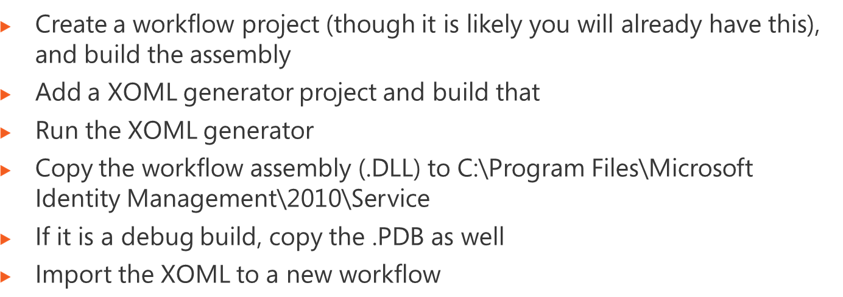
Notes:
Module x: Title
Course xxxxy

Slide 18
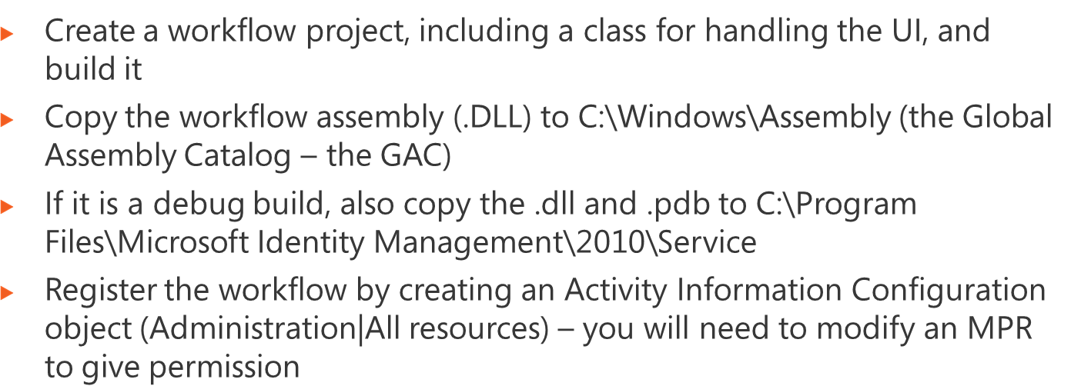
Notes:
Module x: Title
Course xxxxy

Slide 19
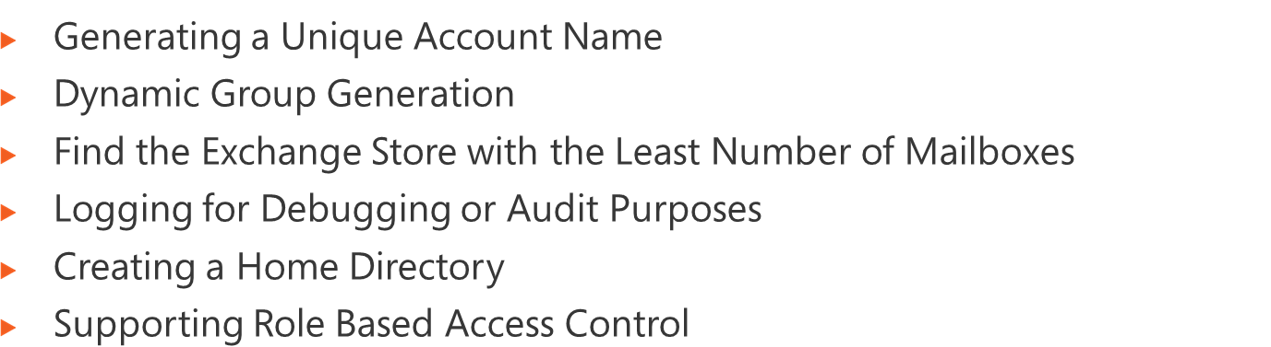
Notes:
Module x: Title
Course xxxxy

Slide 20
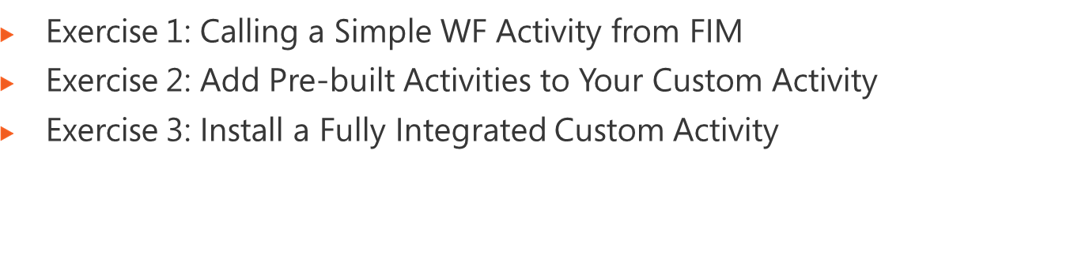
Logon information
Virtual machine | FIM2010RC1
User name | Administrator
Password | Pa$$w0rd
Estimated time: 60 minutes
Notes:
Module x: Title
Course xxxxy
In this lab, students will ….
Exercise 1
In this exercise, students ….
Exercise 2
In this exercise, students ….
Before the students begin the lab, read the scenario associated with each exercise to the class. This will reinforce the broad issue that the students are troubleshooting and will help to facilitate the lab discussion at the end of the module. Remind the students to complete the discussion questions after the last lab exercise.
If this is a KonaH product, use this note:
Note: The lab exercise answer keys are provided on the Course Companion CD. To access the answer key, click the link located at the bottom of the relevant lab exercise page.
If this is a Forte product, use this note:
Note: The lab exercise answer keys are provided on the Course CD.

